Slide 1
Binary Trees
Week – 9

Slide 2
Binary Tree
Given an ordered linked list of items the only way to search for a given item is to perform a linear search.
This is O(n), where n is the number of items in the list.
Is it possible to re-arrange the nodes so that a binary search of the items is possible?
Why? Because binary search gives us O(log n).

Slide 3
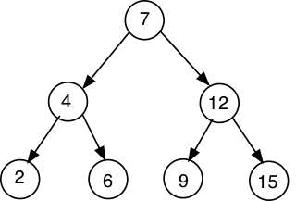
Binary Tree
Definition:
A binary tree is a finite set of nodes that either is empty or consists of a root node
Each node consists of two disjoint binary trees called the left and right sub-trees of the root.

Slide 4
Binary Tree
Node: A node is an element in the tree.
Root node: Topmost node, serving as the entry point to the tree structure. It has no parent node and is the starting point from which all other nodes branch out.
Edges: Each node is connected to its parent and descendants by arcs called edges.
Terminal nodes: Nodes are either terminal, in which case they have no descendants (called leaves).
Not terminal: In this case they have descendants and are called interior nodes.

Slide 5
Binary Tree
Root node
edges
Interior nodes
Interior nodes
Leaf node
Leaf
Leaf
Leaf
Root node = 7
Interior nodes = 4, 12
Leaf nodes: 2, 6, 9, 15

Slide 6
Binary Tree
Parent
Child of 7
Child of 7
Siblings
Siblings
Siblings
Child of 4
Child of 4
Child of 12
Child of 12
Children of node 7: (4, 12)
Children of 4: (2, 6)
Children of 12: (9, 15)
Siblings: (4, 12), (2, 6), (9, 15)

Slide 7
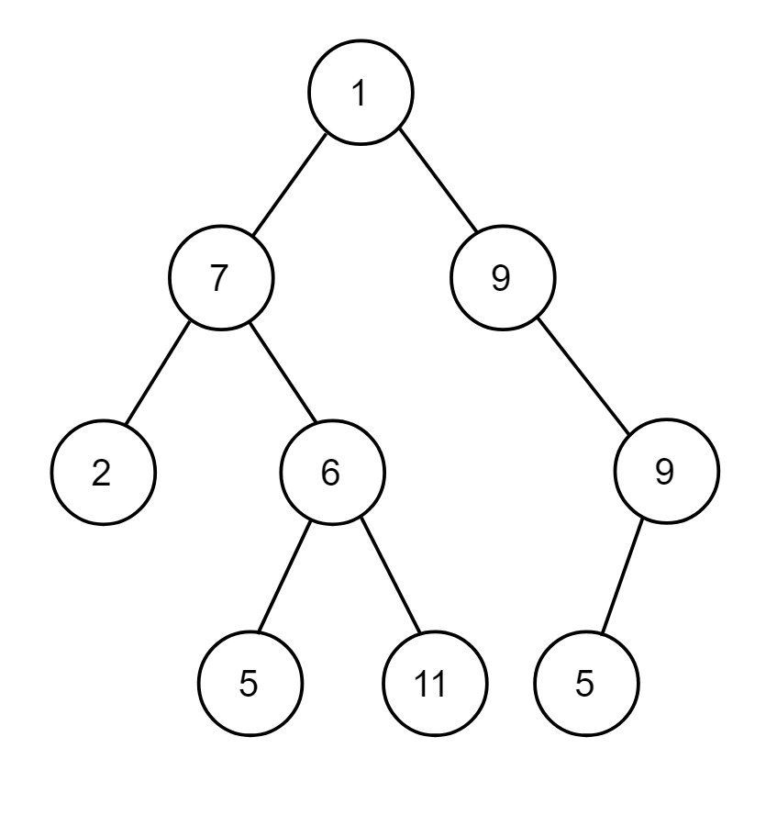
Binary Tree – Exercise
Find:
Root node:
leaf nodes:
Interior nodes:
Children of node 1:
Children of node 7:
Children of node 6:
Children of node 9:
Children of node 9:
Children of node 2:
Siblings:

Slide 8
Binary Tree – Exercise – solution
Find:
Root node: 1
leaf nodes: 5, 11, 5
Interior nodes: 7, 9, 2, 6, 9
Children of node 1: (7, 9)
Children of node 7: (2, 6)
Children of node 6: (5, 11)
Children of node 9: (9)
Children of node 9: (5)
Children of node 2: no children
Siblings: (7, 9), (2, 6), (5, 11)

Slide 9
Binary Tree
Degree: The number of direct descendants of an interior node is called its degree. In a binary tree, the degree refers to the maximum number of children that a node can have.
In the case of binary trees, the degree is a max of 2 because of left and right node.
Height: The number of edges that have to be traversed from the root node to a node k is called the path length or height of k.
In general, a node at level j has path length j-1, assuming path length of the root node is 0
The height of a tree is the maximum path length associated with any of its nodes

Slide 10
Binary Tree - Example:
Degree: 2 because each node has two descendants/ children/nodes.
Height of the tree: 2 because form the root node 7 → to leaf nodes 2, 6, 9, 15, we have to travel through two edges.
Height of node 4: 1
Height of node root node 7: 0
Height of node 2: 2
Height of the tree 2
Degree 1
Degree 2

Slide 11
Binary Tree - Example:
Level of the tree: number of levels / stages in the tree
Level 1
Level 2
Level 3

Slide 12
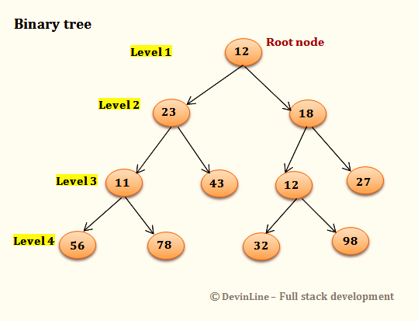
Binary Tree - Example:
Level of the tree: number of levels / stages in the tree

Slide 13
Binary Tree - Example:
how do we compute the path length for each node? Consider node = k:
Pathlength of node k = j-1
For k = 7, it will be 0.
For k =4, it will be number of edges it crossed from the root node which is 1.
For k = 2, it will be 2.
Level = j
Let’s say level of root node = j so path length = j-1 = 1-1
For node 12, path length = j -1 = 2 – 1 = 1
For node 15, path length = j – 1 = 3 – 1 =2
Level 1, (j = 1)
Level 2, (j = 2)
Level 3, (j = 3)

Slide 14
Binary Tree- Exercise:
Find:
Degree of the tree:
height of the tree:
Levels of the tree:
Consider level = j and node = k, find the path for:
K = 7
K = 2
K = 6
K = 5
K = 9

Slide 15
Binary Tree – Exercise
How many leaf nodes and what are these?
How many interior nodes and which are these?
What is the root node?
What is the height of the tree?
What is height of 12 given that root has height of 0?
What is the degree of the tree?
How many levels of the tree?
What are the siblings?

Slide 16
Examples of Binary Trees:
A family tree inverted, where parents are viewed as descendants. Like a parent-child relation.

Slide 17

Binary Search Tree
Definition: A binary tree with the additional constraints:
The value in every node must be greater than all values in its left sub-tree, and less than all values in its right sub-tree.
Duplicate values are not allowed.
Given a sorted list, the root node will be the middle element. For example, list: [ 2,4,6,7,9,12,15] the root node will be 7.

Slide 18
Binary Search Tree
Can this be a binary search tree?
Why?
Why not?

Slide 19
Binary Search Tree
Create a binary search tree from the given list.
Binary Search of the sorted list: [ 2,4,6,7,9,12,15]

Slide 20

Binary Search Tree
Search the element 4 from the tree from the given list.
Binary Search of the sorted list: [ 2,4,6,7,9,12,15]
Start at 7 (middle element)
Is that the one we are looking for?
If not, go left or go right?
If found, true else end of the tree

Slide 21
Binary Search Tree – Optimization
To optimize the cost of searching, we could store items in the structure of the comparison tree itself.
The main goal is to reduce the time complexity and optimize the algorithm.
The total complexity is O(logn) which is more efficient.
In a binary tree, the task is clear that the lower number will go to the left and the higher one will go to the right.
So, our task is clear, and we only have to compare each number with the root node. That’s why it has less complexity.

Slide 22
Binary Search Tree – Optimization
This would give rise to a retrieval cost of O(log N) and an insertion cost of O(log N) on condition that the number of left nodes is approximately equal to the number of right nodes

Slide 23
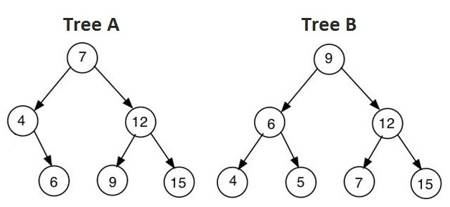

Binary Search Tree
Does tree A satisfy the condition of a binary tree? Yes.
Does tree B satisfy the condition of a binary tree? Yes.
Does tree A satisfy the condition of a binary search tree? Yes.
Does tree B satisfy the condition of a search tree? No. Why?

Slide 24
Binary Search Tree
Create a list of values given a binary search tree.
This type of search gives rise to an inverted tree structure.
What’s the difference here? Previously you had the list, and you created a tree. Here you have the tree, and you have to create a list.
How will you create a list?
Visit each node in a specific order.
4,2,6,7,12,9,15

Slide 25
Traversing Tree
There are three natural ways in which we can visit each node in a binary tree.
These are based on the recursive nature of the tree structure.
They are:
Preorder (also the functions will be used in programming.)
Inorder
Postorder

Slide 26
Traversing Tree
Preorder process(or visit) root
process left sub-tree
process right sub-tree
Inorder process left sub-tree
process root
process right sub-tree
Postorder process left sub-tree
process right sub-tree
process root

Slide 27
Example
Preorder: root, left, right
inorder: left, root, right.
Postorder: left, right, root
Inorder will always in a sorted way

Slide 28
Traversing Tree
Preorder: root, left, right: 7, 4, 2, 6, 12, 9, 15

Slide 29
Traversing Tree
inorder: left, root, right: 2, 4, 6, 7, 9, 12, 15
inorder traversal of a Binary Search Tree always gives a sorted list of values

Slide 30
Traversing Tree
Postorder: left, right, root: 2, 6, 4, 9, 15, 12, 7

Slide 31
Add new values
When adding a new value we must ensure that the value in every node must be greater than all values in its left sub-tree, and less than all values in its right sub-tree is invariant.
A new value is added as a leaf node in such a way that this rule is preserved.

Slide 32
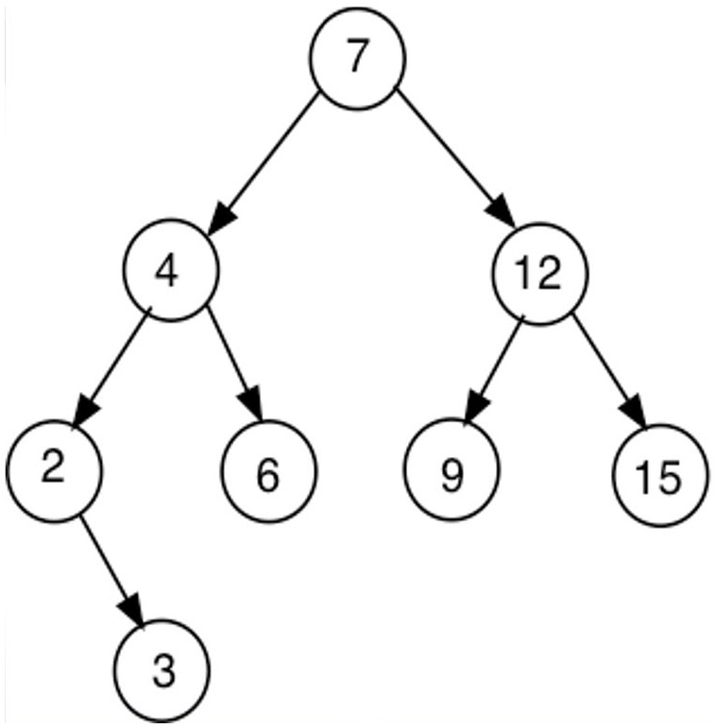
Add 3

Slide 33
Exercise – Traversal BST
To construct a binary search tree from a given list of values the first item on the list becomes the root node.
Exercise
Construct a binary search tree from the list: 8,4,6,2,5,10,1,9,7.
List values based on each of the traversals defined above.
Pre-order: root; left; right
Inorder: left; root; right
Post-order: left; right; root

Slide 34
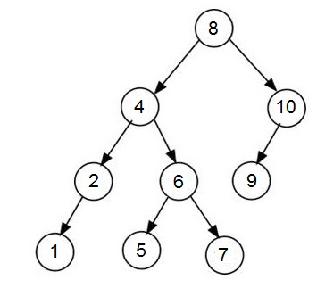
Answer
List: 8,4,6,2,5,10,1,9,7

Slide 35
Traversals
Pre-order: root; left; right
List: 8, 4, 2, 1, 6, 5, 7, 10, 9

Slide 36
Traversals
Inorder: left; root; right
List: 1, 2, 4, 5, 6, 7, 8, 9, 10

Slide 37
Traversals
Post-order: left; right; root
List: 1, 2, 5, 7, 6, 4, 9, 10, 8

Slide 38
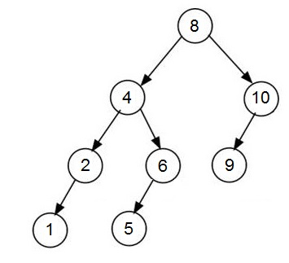
Delete an element
Delete a leaf node (number 7)

Slide 39
Delete an element
Removing the leaf node is simpler.
How do we remove the descendant nodes?

Slide 40
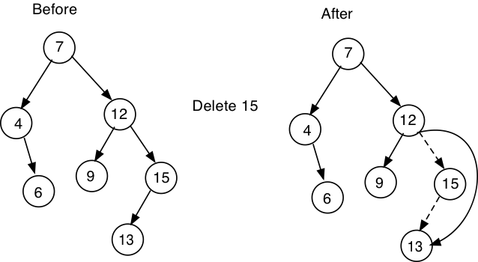
Single Descendant – delete 15

Slide 41
Single Descendant – delete 15
Single descent means a node that only has 1 descent or the following node.
If we remove edge 15, then we will need to join 12 and 13.
The new descendant of 12 will be 1.

Slide 42
Two Descendants
When deleting a node that has 2 or more descendants, things get a little more complicated.
We must replace the data item with some other element in the tree such that its invariant property is preserved.
Two possible solutions are to replace the value in the node to be deleted with:
Maximum value in its left sub-tree and then delete this node
Minimum value in the right sub-tree and then delete this node

Slide 43
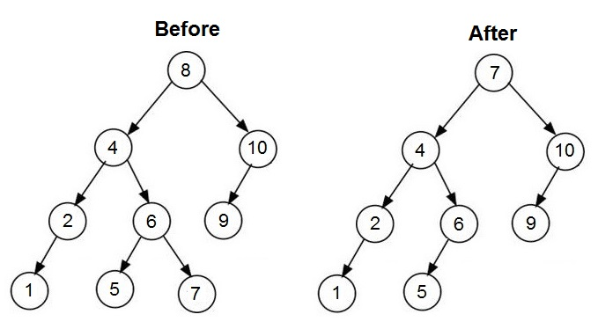
Exercise
Delete node 8 from the following tree:

Slide 44
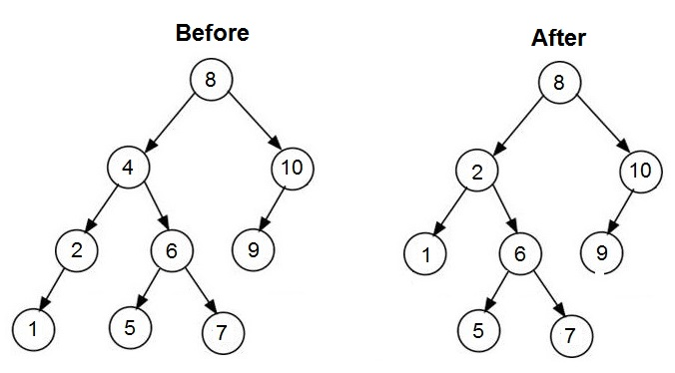
Exercise
Delete node 4 from the following tree:

Slide 45
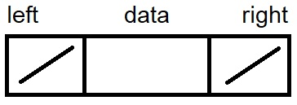
Implementing a Binary Search Tree
A binary search tree has to maintain a sorted list of data elements and, hence, its generic type must supply a compareTo method.
We are using compareTo because each time we need to compare the node with each other or with node.
Each node has degree 2 and, hence, has to have a left and right reference to possible descendants.
A picture of a node might be: take it as doubly linked list where we have everything associated. The data here will be the node, then left and right edges.

Slide 46
Implementing a Binary Tree
private class BNode<E extends Comparable<E>>{
private E data;
private BNode<E> left;
private BNode<E> right;
public BNode(E d){
data = d; left = null; right = null; }
public E data(){return data;}
public void set(E x){data = x;}
public BNode<E> left(){ return left;}
public BNode<E> right(){return right;}
public void setLeft(BNode<E> k){left = k;}
public void setRight(BNode<E> k){right =k;}
}

Slide 47
Implementing a Binary Tree
A new instance of BNode below always initializes both descendants to null.
The constructor takes a single instance of type E as an argument and initializes the data attribute.
This value may also be modified using a set and retrieved with the data method.
The methods setLeft and setRight are used to connect child nodes.

Slide 48
Search
public boolean contains(E x){
return contains(root, x);
}
Contain will return whether the x element is present or not. It will check the root first and then left or right.

Slide 49
private boolean contains(BNode<E> rt, E x){
if(rt == null) return false;
else{
if(rt.data().equals(x)) return true;
else if(x.compareTo(rt.data()) < 0)
return contains(rt.left(),x);
else
return contains(rt.right(), x);
}
}
Rt is root. If root is null, it will return false.
If root is x your given input, it will return tru.
If x is less than rt.data then, it will return left element.
If x is greater than rt.data, It will return right element.
Check why less than 0?

Slide 50
Traversals(p194)
public ArrayList<E> inOrder(){
ArrayList<E> lst = new ArrayList<E>();
inOrder(root,lst);
return lst;
} we are creating an array here with inorder traversal. Ascending order. If the root is not null, it will go to the function which will go the left then root, then right.
private void inOrder(BNode<E> rt, ArrayList<E> lst){
if(rt != null){
inOrder(rt.left(), lst); //process left sub-tree
lst.add(rt.data()); //process root
inOrder(rt.right(),lst); //process right sub-tree
}
}

Slide 51
Traversals(p194)
public ArrayList<E> preOrder(){
ArrayList<E> lst = new ArrayList<E>();
preOrder(root,lst);
return lst;
} same goes for pre-order. You will add the root first. You will always start from the root.
private void preOrder(BNode<E> rt,
ArrayList<E> lst){
if(rt != null){
lst.add(rt.data()); //process root
preOrder(rt.left(), lst); //process left sub-tree
preOrder(rt.right(),lst); //process right sub-tree
}
}

Slide 52
public ArrayList<E> postOrder(){
ArrayList<E> lst = new ArrayList<E>();
postOrder(root,lst);
return lst;
}
private void postOrder(BNode<E> rt, ArrayList<E> lst){
if(rt != null){
postOrder(rt.left(), lst); //process left sub-tree
postOrder(rt.right(),lst); //process right-subtree
lst.add(rt.data()); //process root
}
}

Slide 53
Delete
Remove works as follows:
Find the node to delete
If this node is a leaf node just drop it
else if left node null then return right sub-tree
else if right node null then return left sub-tree
else{ replace node value with value of rightmost element in its left sub-tree;
drop this leaf node
} we need to find that elemnt

Slide 54
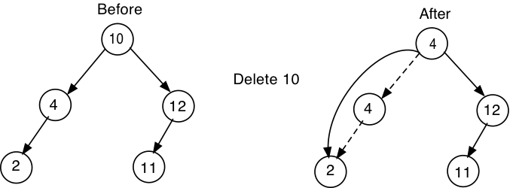
Sample Diagram

Slide 55
The code is given in the book
Note you are not expected to reproduce the code in the exam but you are expected to be able to use the algorithm given a binary search tree diagram

Slide 56
Breadth First Traversal
The three iterations inOrder, preOrder and postOrder each provide a depth first traversal of the tree.
A breadth first traversal of the tree would visit each node in the tree level by level starting at the root.
For example, the nodes in the tree below would be visited in the following order: 7,4,12,2,6,9,15,3

Slide 57
Breadth First
7, 4, 12, 2, 6, 9, 15, 3

